Slide 1
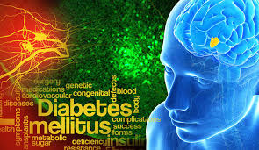


PREDICTING DIABETES USING MACHINE LEARNING

Slide 2
INTRODUCTION
Diabetes is one of the deadliest diseases in the world. It is not only a disease but also creator of different kinds of diseases like heart attack, blindness etc. The normal identifying process is that patients need to visit a diagnostic center, consult their doctor, and sit tight for a day or more to get the report.
Cause of Diabetes vary depending on the genetic makeup, family history, ethnicity, health etc.
Diabetes and pre-diabetes is diagnosed by blood test.

Slide 3
INTRODUCTION
The number of people with diabetes has risen from 108 million in 1980 to 422 million in 2014 (1).
The global prevalence of diabetes* among adults over 18 years of age has risen from 4.7% in 1980 to 8.5% in 2014 (1).
Diabetes prevalence has been rising more rapidly in middle- and low-income countries.
Diabetes is a major cause of blindness, kidney failure, heart attacks, stroke and lower limb amputation.
In 2015, an estimated 1.6 million deaths were directly caused by diabetes. Another 2.2 million deaths were attributable to high blood glucose in 2012**.
Almost half of all deaths attributable to high blood glucose occur before the age of 70 years. WHO projects that diabetes will be the seventh leading cause of death in 2030 (1).
Healthy diet, regular physical activity, maintaining a normal body weight and avoiding tobacco use are ways to prevent or delay the onset of type 2 diabetes.
Diabetes can be treated and its consequences avoided or delayed with diet, physical activity, medication and regular screening and treatment for complications.

Slide 4

Cross-industry standard process for data mining (CRISP-DM)
CRISP-DM process is used to better understand the problem and give us better insight of whole process.
CRISP-DM has six phases

Slide 5
BUSINESS UNDERSTANDING
What is the profound question ?
To identify whether the patient is having diabetes or not?
Goal
Goal is to identify the probability of diabetes in patients using machine learning
Advantage
The rules derived will be helpful for Healthcare Professionals to identify patients suffering from diabetes. Further predicting the disease early leads to treating the patient before it reaches critical stage.

Slide 6
DATA UNDERSTANDING
Data Source
This dataset is originally from the National Institute of Diabetes and Kidney Diseases.
This dataset has 769 samples of diabetic and healthy individuals.
All patients here are females of at least 21 years of age.
Diabetes dataset is credited to UCI Machine Learning database repository.

Slide 7
DATA UNDERSTANDING
Data Set Details:
Dataset has total 9 attributes out of which 8 are independent variables and one is dependent variable i.e. target variable which determines whether patient is having diabetes or not.
Sample Data
Pregnancies | Glucose | BloodPressure | SkinThickness | Insulin | BMI | DiabetesPedigreeFunction | Age | Outcome
6 | 148 | 72 | 35 | 0 | 33.6 | 0.627 | 50 | 1
1 | 85 | 66 | 29 | 0 | 26.6 | 0.351 | 31 | 0
8 | 183 | 64 | 0 | 0 | 23.3 | 0.672 | 32 | 1
1 | 89 | 66 | 23 | 94 | 28.1 | 0.167 | 21 | 0
0 | 137 | 40 | 35 | 168 | 43.1 | 2.288 | 33 | 1
5 | 116 | 74 | 0 | 0 | 25.6 | 0.201 | 30 | 0
3 | 78 | 50 | 32 | 88 | 31 | 0.248 | 26 | 1
10 | 115 | 0 | 0 | 0 | 35.3 | 0.134 | 29 | 0
2 | 197 | 70 | 45 | 543 | 30.5 | 0.158 | 53 | 1

Slide 8
DATA UNDERSTANDING
Attributes Details:
Pregnancies: Number of times pregnant
Glucose: Plasma Glucose Concentration a 2 hour in an oral glucose tolerance test (mg/dl) A 2-hour value between 140 and 200 mg/dL (7.8 and 11.1 mmol/L) is called impaired glucose tolerance. This is called "pre- diabetes." It means you are at increased risk of developing diabetes over time. A glucose level of 200 mg/dL (11.1 mmol/L) or higher is used to diagnose diabetes.
Skin Thickness: Triceps Skin Fold Thickness (mm) – A value used to estimate body fat. Normal Triceps SkinFold Thickness in women is 23mm. Higher thickness leads to obesity and chances of diabetes increases.
Insulin: 2-Hour Serum Insulin (mu U/ml) Normal Insulin Level 16-166 mIU/L Values above this range can be alarming.

Slide 9
DATA UNDERSTANDING
Attributes Details:
BMI: Body Mass Index (weight in kg/ height in m2) Body Mass Index of 18.5 to 25 is within the normal range BMI between 25 and 30 then it falls within the overweight range. A BMI of 30 or over falls within the obese range.
Diabetes Pedigree Function: It provides information about diabetes history in relatives and genetic relationship of those relatives with patients. Higher Pedigree Function means patient is more likely to have diabetes.
Age (years)
Outcome: Class Variable (0 or 1) where ‘0’ denotes patient is not having diabetes and ‘1’ denotes patient having diabetes The dependent variable is whether the patient is having diabetes or not.

Slide 10
DATA PREPARATION
Data cleaning and transforming data if needed.
Handling Zero / Null values – Zeros for some attribute values are not zeros but null values. This is based on inference that certain attributes like skin thickness, insulin, BMI cannot be zero.
Pregnancies | Glucose | BloodPressure | SkinThickness | Insulin | BMI | Diabetes Pedigree Function | Age | Outcome
6 | 148 | 72 | 35 | 0 | 33.6 | 0.627 | 50 | 1
1 | 85 | 66 | 29 | 0 | 26.6 | 0.351 | 31 | 0
8 | 183 | 64 | 0 | 0 | 23.3 | 0.672 | 32 | 1
1 | 89 | 66 | 23 | 94 | 28.1 | 0.167 | 21 | 0
0 | 137 | 40 | 35 | 168 | 43.1 | 2.288 | 33 | 1
5 | 116 | 74 | 0 | 0 | 25.6 | 0.201 | 30 | 0
3 | 78 | 50 | 32 | 88 | 31 | 0.248 | 26 | 1
10 | 115 | 0 | 0 | 0 | 35.3 | 0.134 | 29 | 0
2 | 197 | 70 | 45 | 543 | 30.5 | 0.158 | 53 | 1

Slide 11
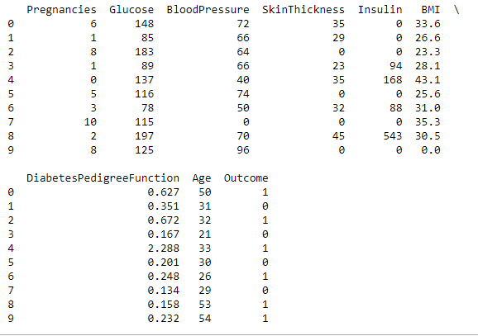
DATA PREPARATION

Slide 12
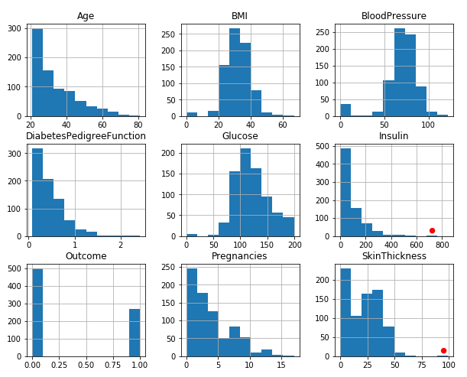
DATA PREPARATION
Check and remove outliers
This graph shows the distribution of different attributes. By carefully studying the graph outliers were identified. Red dots depict the outliers.

Slide 13
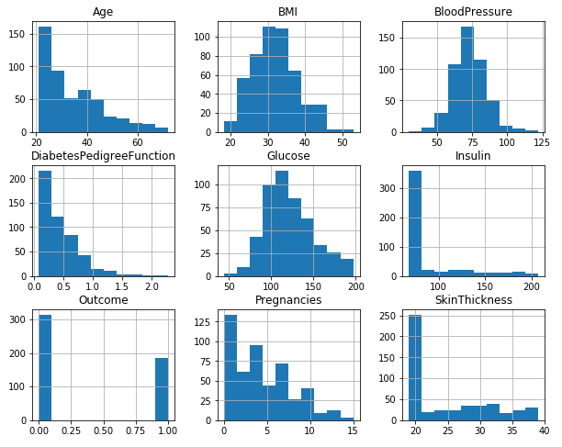
DATA PREPARATION
Outliers were found in Insulin and Skin Thickness attributes. They were removed using IRQ (Inter Quartile Range) method.

Slide 14
DATA PREPARATION
Select appropriate attributes for analysis.
This dataset consists of 9 attributes i.e. Pregnancies, Glucose, Blood Pressure, Diabetes Pedigree Function, Age, Skin Thickness, Insulin, BMI. These 8 are independent attributes and one i.e. Outcome is the dependent attribute.
As all these attributes affect diabetes so we decided to keep all the independent variables for data mining process.
Data Splitting:
Data was divided into training and testing data into 60:40 ratio. Sixty percent was training data and forty percent was testing data.

Slide 15
DATA PREPARATION
Different ranges were found out for each continuous variable in the data set. Based upon these ranges categorization was done.
Features were categorized as per the below mentioned ranges and denoted by 0,1, 2 & 3, in order to use them for classification.
Glucose
Blood Pressure(Diastolic)
Ranges | Low | Normal | High
 | Below 60 (0) | 60-90 (1) | 90 or more (2)

Slide 16
DATA PREPARATION
Skin Thickness
Ranges | Low | Normal | High
 | <23 (0) | 23 (1) | >23 (2)
Insulin
Ranges | Low | Normal | High
2 Hours After Glucose | <16 mIU/L (0) | 16-166 mIU/L (1) | >166 mIU/L (2)
BMI(weight in kg/ height in m²)
Ranges | Under-weight | Normal | Over-weight | Obese
 | <18.5 (0) | 18.5-25 (1) | 25-30 (2) | >30 (3)
Diabetes Pedigree Function
 | Low | Medium | High
 | 0-0.78 (0) | 0.79-1.561 (1) | >1.57 (2)

Slide 17
DATA PREPARATION
Age
Ranges | Young | Adult | Old
 | 20-44 (0) | 44-64 (1) | 64-100 (2)
No.of Pregnancies
Ranges | Normal | Above Normal | Highest
 | <6 (0) | 6-12 (1) | >12 (2)

Slide 18
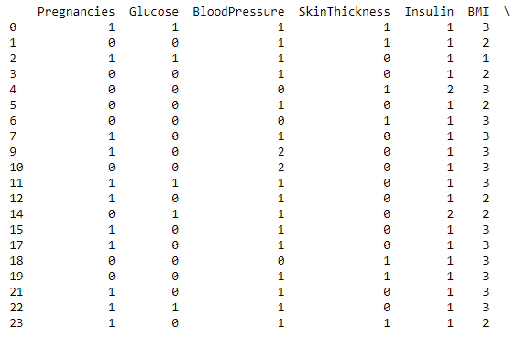
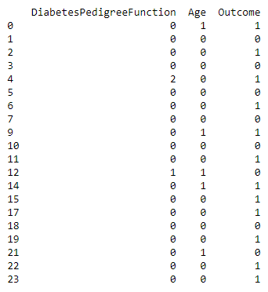
DATA PREPARATION
The tables shows the data after categorization. Different ranges taken for categorization of data are denoted by 0,1, 2 & 3.

Slide 19
MODELING
This phase includes application of appropriate model to the data.
Machine Learning Algorithms were used for modeling.
As we have to classify the data into patients having diabetes or not, we used Classification and Regression Tree Algorithm(CART) & K-Nearest Neighbor algorithms. Both of these algorithms are good for classifying dependent variables based upon categorized independent variables.
We compared both the algorithms to find the one which gives the best results based upon overall accuracy and precision.

Slide 20
MODELING
Software Used:
Python-Scikit Learn
Scikit-learn provides a range of supervised and unsupervised learning algorithms via a consistent interface in Python.
The library is built upon the SciPy (Scientific Python) that must be installed before we can use scikit-learn. This stack includes:
NumPy: Base n-dimensional array package
SciPy: Fundamental library for scientific computing
Matplotlib: Comprehensive 2D/3D plotting
IPython: Enhanced interactive console
Sympy: Symbolic mathematics
Pandas: Data structures and analysis

Slide 21
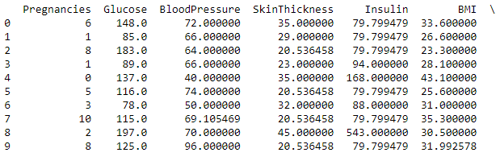
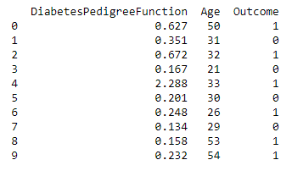
MODELING: USING PYTHON SCIKIT-LEARN
The file containing data set is loaded in pandas

Slide 22
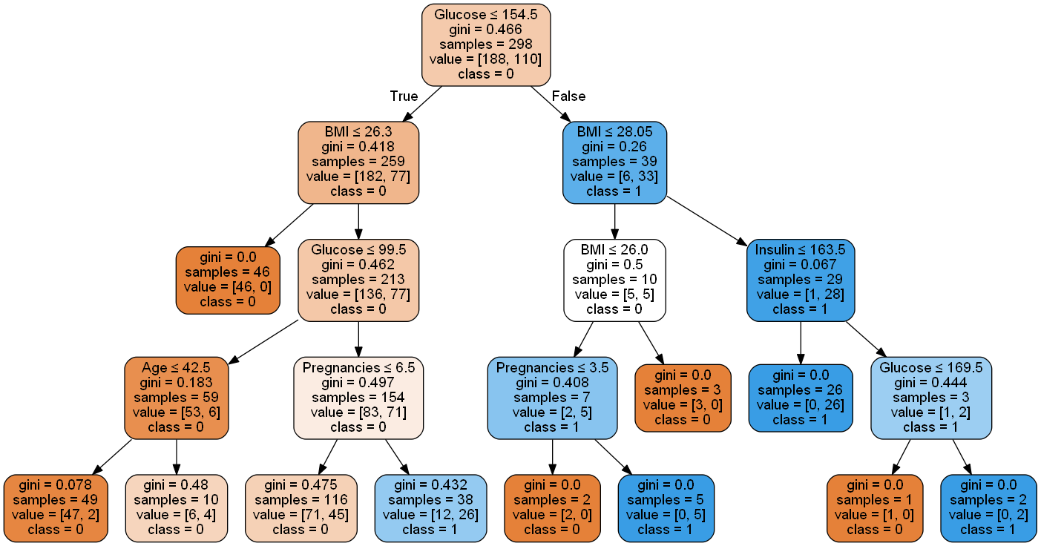
MODELING: USING PYTHON SCIKIT-LEARN
Decision tree model is applied on the training dataset. The Decision Tree obtained gives the best result. The depth taken for this tree is 4 and total number of nodes are 21.

Slide 23
MODELING: USING PYTHON SCIKIT-LEARN
Node Description:
The root node split in this tree started with Glucose attribute.
No of samples – It is the count of those samples whose glucose value is less than 154.5
Value – It gives the total no of samples for outcome ‘0’ and ‘1’. For e.g. in root node the value 188 (represents class ‘0’) is higher than 110 (represents class ‘1’) , so this node is classified as class ‘0’
Class – Diabetic – ‘1’ or Non Diabetic – ‘0’
Gini Impurity – This function measures the quality of a split. This factor measures how a randomly chosen element from the set would be incorrectly classified i.e. It is probability of misclassification of a record. It is used to minimize misclassifications.

Slide 24
MODELING: USING PYTHON SCIKIT-LEARN
Decision Rules
S.No. | Antecedent | Consequent | Support | Confidence
1. | If Glucose<= 154.5 & BMI <= 26.3 | No Diabetes | 46/298 | 1
2. | If Glucose<= 154.5 & BMI <= 26.3 & Glucose <= 99.5 & Age <= 42.5 | No Diabetes | 47/298 | 0.95
3. | If Glucose<= 154.5 & BMI <= 26.3 & Glucose <= 99.5 & Age <= 42.5 | No Diabetes | 6/298 | 0.60
4. | If Glucose<= 154.5 & BMI <= 26.3 & Glucose <= 99.5 & Pregnancies<= 6.5 | No Diabetes | 71/298 | 0.61
5. | If Glucose<= 154.5 & BMI <= 26.3 & Glucose <= 99.5 & Pregnancies<= 6.5 | Diabetes | 26/298 | 0.68
6. | If Glucose<= 154.5 & BMI <= 28.05 & BMI <= 26.00 | No Diabetes | 3/298 | 1
7. | If Glucose<= 154.5 & BMI <= 28.05 & BMI <= 26.00 & Pregnancies <= 3.5 | No Diabetes | 2/298 | 1
8. | If Glucose<= 154.5 & BMI <= 28.05 & BMI <= 26.00 & Pregnancies <= 3.5 | Diabetes | 5/298 | 1
9. | If Glucose<= 154.5 & BMI <= 28.05 & Insulin <= 163.5 | Diabetes | 26/298 | 1
10. | If Glucose<= 154.5 & BMI <= 28.05 & Insulin <= 163.5 & Glucose <= 169.5 | No Diabetes | 1/298 | 1
11. | If Glucose<= 154.5 & BMI <= 28.05 & Insulin <= 163.5 & Glucose <= 169.5 | Diabetes | 2/298 | 1

Slide 25
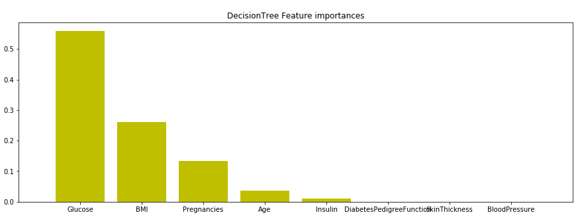
EVALUATION
Feature Importance
With the help of decision tree, we were able to figure out which features played an important role.
This graph depicts the highest importance features.
Decision Tree Feature Ranking
1. | Glucose | 0.558787
2. | BMI | 0.260081
3. | Pregnancies | 0.134401
4. | Age | 0.036539
5. | Insulin | 0.010191
6. | Diabetes Pedigree Function | 0.000000
7. | Skin Thickness | 0.000000
8. | Blood Pressure | 0.000000

Slide 26
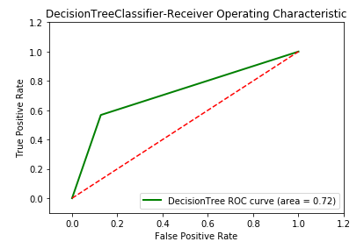
EVALUATION
ROC CURVE
The green line depicts Decision Tree curve area which is 0.72.
The dashed line in the diagonal represents the ROC curve of a random predictor. The random predictor is commonly used as a baseline to see whether the model is useful or not.

Slide 27
EVALUATION
The graph is called a Receiver Operating Characteristic curve (or ROC curve.) It is a plot of the true positive rate against the false positive rate for the different points.
It shows the tradeoff between True Positive Rate (TPR) and False Positive Rate (FPR) (any increase in (TPR) will be accompanied by a decrease in (FPR)).
The closer the curve towards TPR of the ROC space, the more accurate the test.
The closer the curve towards the FPR of the ROC space, the less accurate the test.
The Area Under the Curve (AUC) is a measure to determine the model effectiveness. The more AUC for a model comes to 1, the better it is. So models with higher AUCs are preferred over those with lower AUCs.

Slide 28
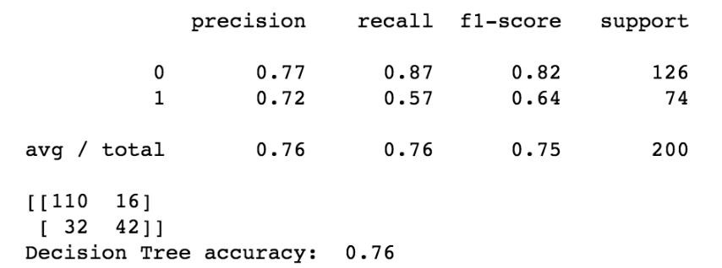
EVALUATION
Confusion Matrix
true positives (TP): These are cases in which we correctly predicted diabetes as result.
true negatives (TN): We correctly predicted no diabetes and they don't have the disease.
false positives (FP): We correctly predicted no diabetes, but they actually had the disease. (Also known as a "Type I error.")
false negatives (FN): We correctly predicted diabetes, but they actually
had no disease. (Also known as a "Type II error.")
 | Predicted Yes | Predicted No
Actual Yes | tp (true positive) | fp (false positive)
Actual No | fn (false negative) | tn (true negative)
Confusion Matrix for the Decision Tree
Accuracy = tp + tn
tp+tn+fp+fn Precision = tp
tp+fp
Recall = tp
tp+fn
 | Predicted Diabetes | Predicted No Diabetes
Actual Diabetes | 110 | 16
Actual No Diabetes | 32 | 42
The Accuracy for the Decision Tree is 76%

Slide 29
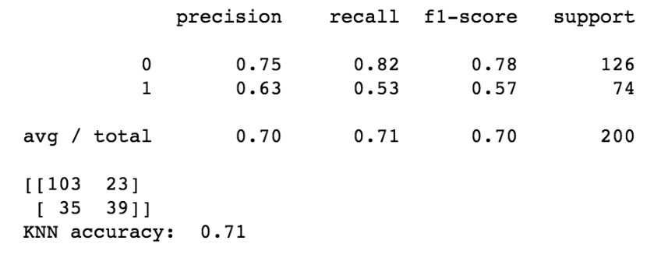
ALTERNATE MODEL COMPARISION
Another machine learning algorithm was tried to compare the accuracy of the model.
K-Nearest Neighbor algorithm was used. The results obtained are as under:
Confusion Matrix KNN
Confusion Matrix Decision Tree
 | Predicted Diabetes | Predicted No Diabetes
Actual Diabetes | 103 | 23
Actual No Diabetes | 35 | 39
 | Predicted Diabetes | Predicted No Diabetes
Actual Diabetes | 110 | 16
Actual No Diabetes | 32 | 42
The Accuracy of KNN Model is 71%
The Accuracy of Decision Tree is 76%.

Slide 30
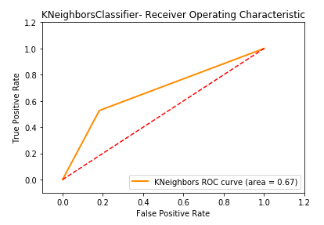
ALTERNATE MODEL COMPARISION
Area Under Curve(AUC) for KNN is 0.67.
Area Under Curve(AUC) for Decision Tree is 0.72.
By comparing both the results we infer that Decision Tree Model is showing better results in comparison to K-Nearest Neighbor Model.

Slide 31
DEPLOYMENT
This is the last and final phase of CRISP-DM process. Deployment includes three important task :
Plan Deployment – Planning basically includes the strategy to be formulated for implementing the model in real world. This model can now be used in medical organizations for easy and early detection of diabetes in patients.
Monitor Deployment – In this, continuous monitoring of model takes place. Regular check is done to ensure model is working fine and if any error occurs can be easily detected.
Generate Reports – Final statistical reports are generated which summarizes the overall performance of the model.

Slide 32
REFERENCES
http://archive.ics.uci.edu/ml/
http://www.who.int/diabetes/en/
Discovering Knowledge in Data: An Introduction to Data Mining, By Daniel T. Larose
Hands-on Machine Learning with Scikit-Learn and Tensorflow, By Aurelien Geron
Machine Learning, by Stephen Marsland
Lecture Notes and Slides
http://scikit-learn.org/stable/
http://pandas.pydata.org/

Slide 33
WHERE TO NEXT ?

Slide 34
THANK YOU

